Slide 1
Data cleaning by example
We're going to cover data cleaning by an example. Primarily, you're going to work in pandas, a library for manipulating tabular data.

Slide 2
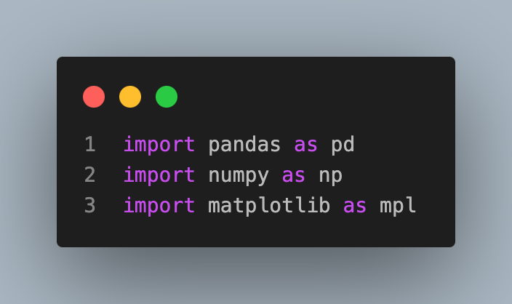
Imports and files
The first thing we'll try is loading some data and plotting it.
Let's load up pandas for data manipulation and matplotlib for plotting
The python command for this is import

Slide 3
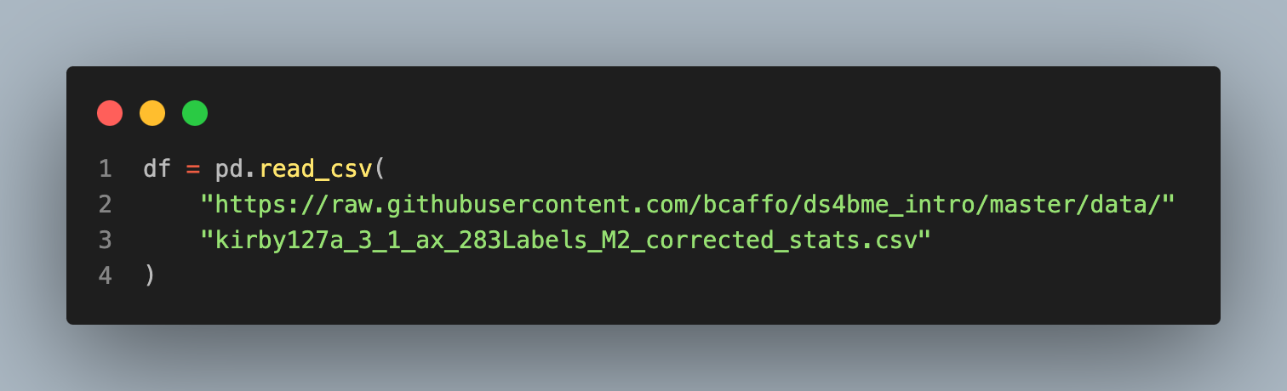
Working with the data
Let's now read in an MRICloud dataset using pandas. We want to use the function read_csv within pandas. Notice we imported pandas as pd so the command is pd.read_csv. Also, pandas can accept URLs, so we just put the link to the file in the argument. The data we want to read in is in a github repo I created.

Slide 4
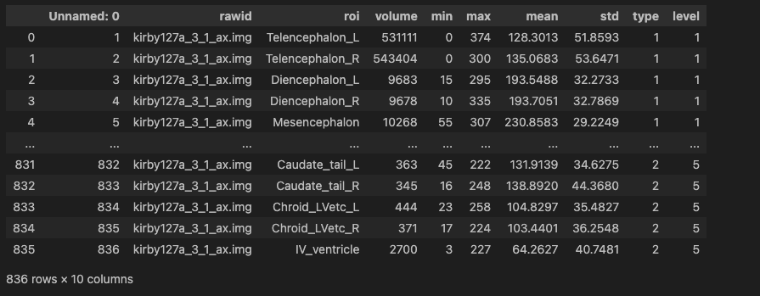
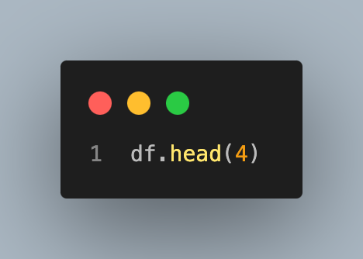
Continued
Let's look at the first 4 rows of our dataframe. The object dataset is a pandas object with associated methods. One is head which allows one to see the first few rows of data.

Slide 5
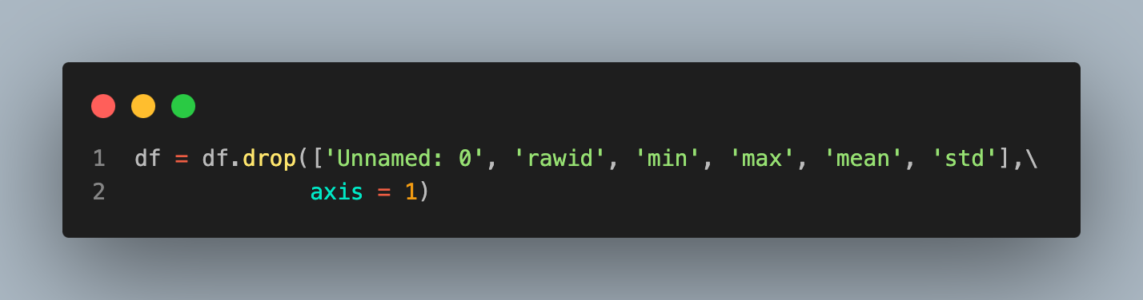
Working with the data
Let's get rid of the column rawid and the unnamed column since they're kind of useless for today's lecture. Also let's work with only the volume.

Slide 6
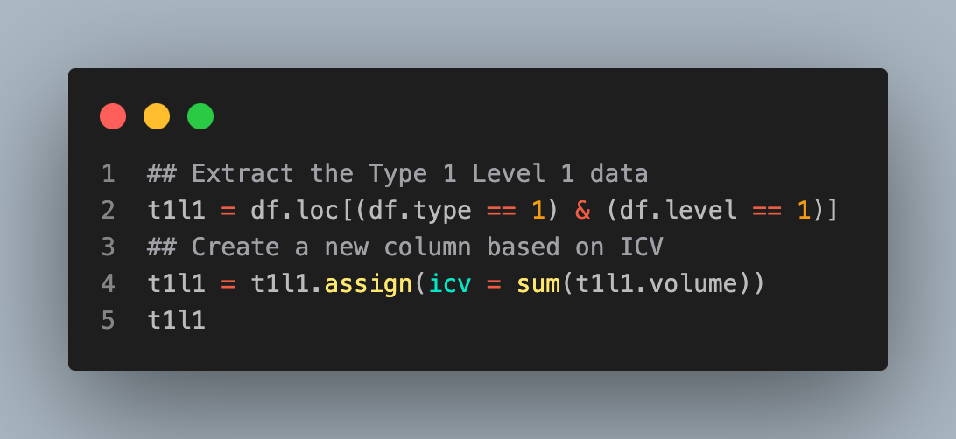
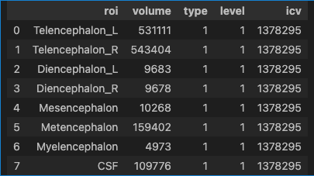
Now let's create a column called icv for intra-cranial volume. ICV is defined as the sum of the Type I Level 1 structures and cerebrospinal fluid. For the rest of this lecture, we're just going to look at this type and level.

Slide 7
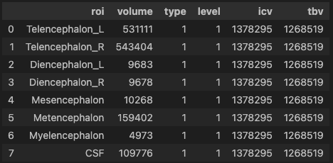
The TBV is defined as the sum of the volume for all rows except CSF.

Slide 8
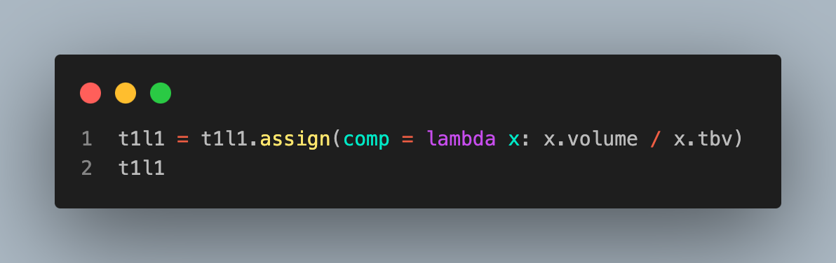
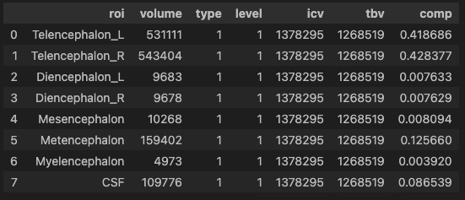
Let's look at brain composition

Slide 9
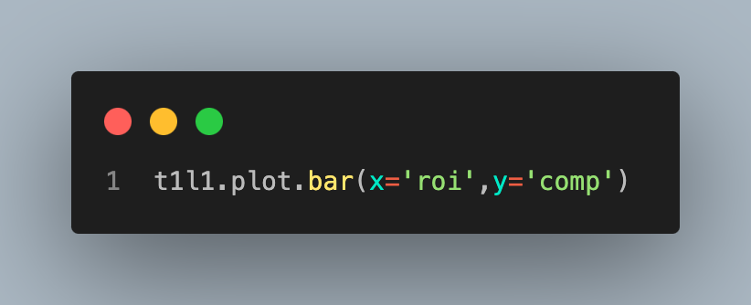
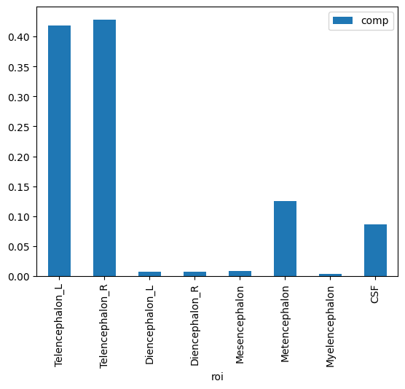
Plotting
Pandas has built in methods for plotting. Later on, we'll try different plotting packages.

Slide 10
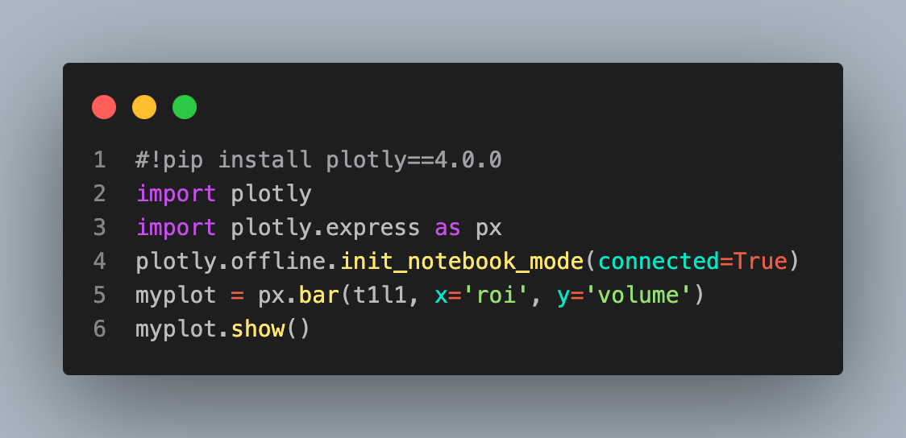
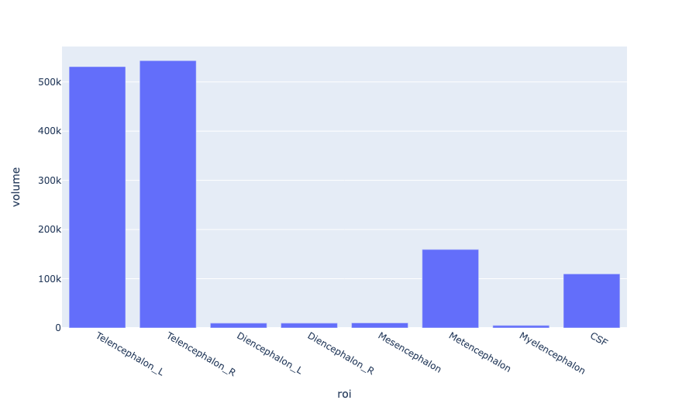
Customizable plot

